Slide 1
GOES-18 Band 07 “Barcode Artifact”
Vertically-Oriented Artifact Impacting One Infrared Band
July 28, 2022

Slide 2
GOES-18 ABI L1b and Imagery Status
The GOES-18 Advanced Baseline Imager (ABI) has completed the majority of its Post-Launch Testing (PLT) calibration and validation activities.
The GOES-18 ABI instrument is performing very well, in family with pre-launch testing, and in family with GOES-16 on orbit performance. Only some product testing and validation remains in the path to full Operations.
PLT started with GOES-18 at 89.5° W, then it drifted to 136.8° W, and finally arrived at 137° W. Once it arrived at 136.8° W in early June, vertically-oriented bars, similar in pattern to a barcode, was discovered in Band 07 (3.9 μm). This “Barcode Artifact” has not yet been mitigated as part of the calibrations.
This barcode artifact is different from the Loop Heat Pipe anomaly-caused degradation seen in GOES-17 ABI infrared bands at certain times. The GOES-18 ABI cooling system underwent a redesign and NOAA and NASA are certain that this artifact is not related to the cooling system. The GOES-18 cooling system is functioning nominally, keeping all detectors cool and stable at 60 K.
Root cause and possible mitigations to the barcode artifact are under investigation.
This reference slide deck will be updated when more characterization has been completed.

Slide 3
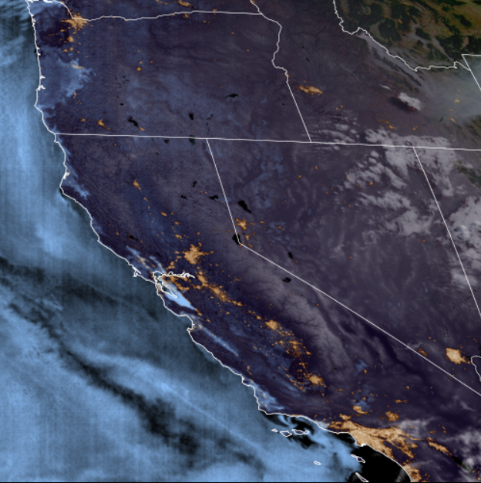
Description of the Barcode Artifact
The barcode artifact is apparent in Band 07, the 3.9 μm band, because it is most susceptible to noise. Earth emits on a small amount of 3.9 μm radiation at night as compared to the other IR bands, limiting the total signal reaching the satellite.
The barcode artifact is most apparent in colder scenes (e.g. at night and cold cloud tops).
When Band 07 is used in multispectral imagery involving differencing, such as the Nighttime Microphysics RGB, the barcode artifact is often apparent.
The barcode artifact is vertically oriented, distinguishing it from detector-level horizontal striping often seen in satellite imagery.
Products that may see impacts
Band 07 L1b and CMI
RGBs
Band differences involving Band 07
Other multispectral imagery products utilizing Band 07
Products that are unlikely to see impacts
Other imagery bands
Any product that does not use Band 07
Some L2 data products that do use Band 07 (e.g. Fire Hot Spot Characterization, ABI-L2-FDC*)
The “barcode artifact” can be seen in low liquid water clouds (colored blue) at night in this GeoColor product (July 21, 2022)

Slide 4
Examples of the Barcode Artifact

Slide 5
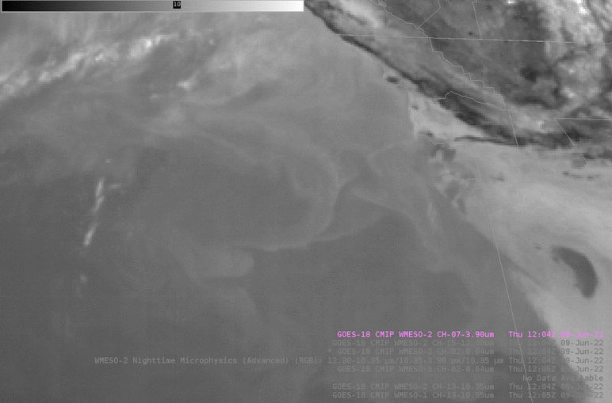
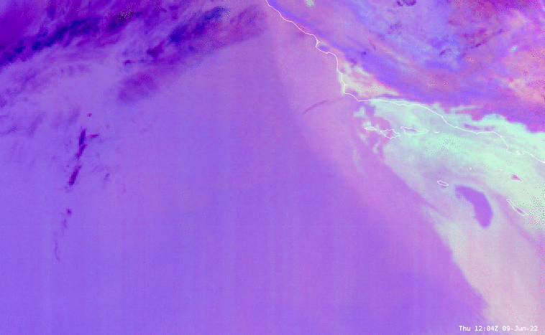
Barcode Artifact Example, 2022/06/09
AWIPS Band 07
AWIPS Nighttime Microphysics RGB
Reference: https://rammb2.cira.colostate.edu/wp-content/uploads/2020/09/QuickGuide_GOESR_NtMicroRGB_Final_20191206.pdf

Slide 6
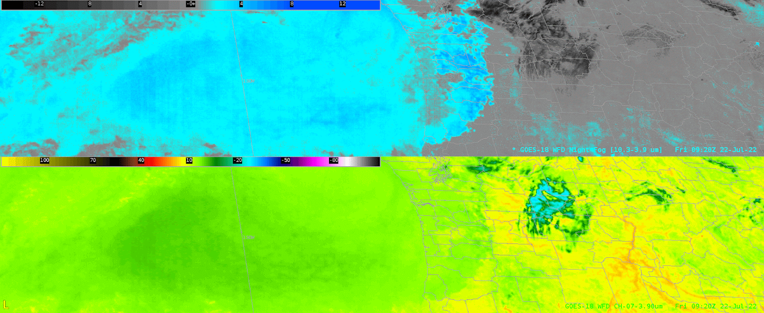
Barcode Artifact Example, 2022/07/22
AWIPS ABI Night Fog Band Difference (10.3 μm – 3.9 μm) (top)
AWIPS Band 07 (bottom)

Slide 7
Examples without the Barcode Artifact

Slide 8
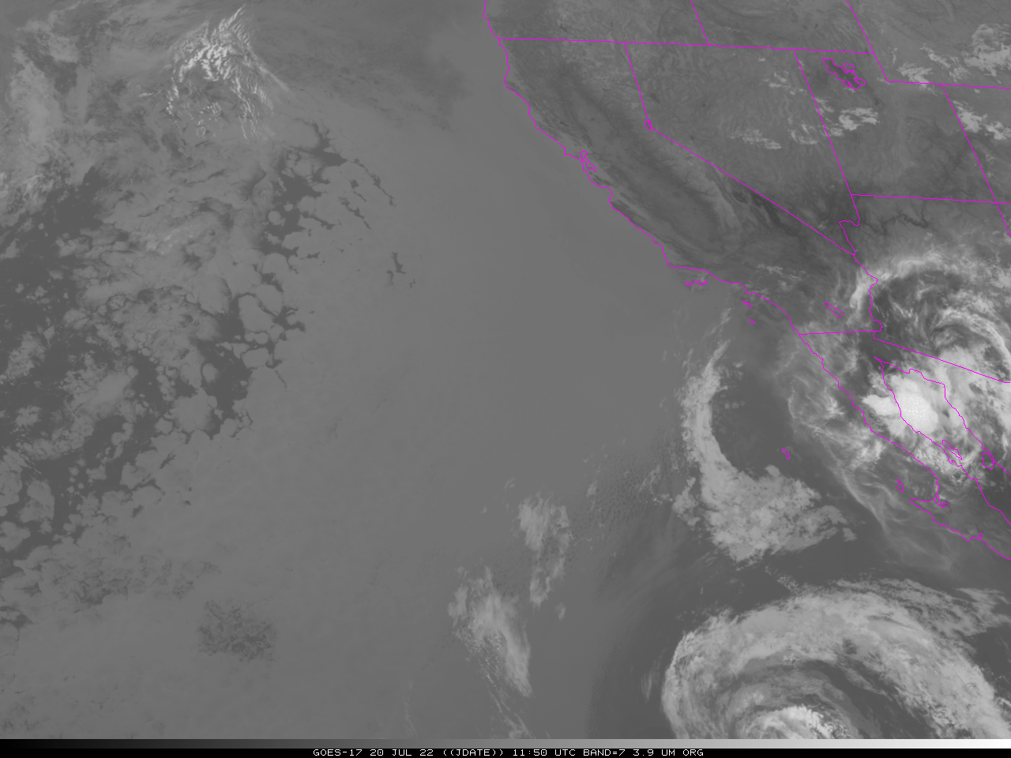
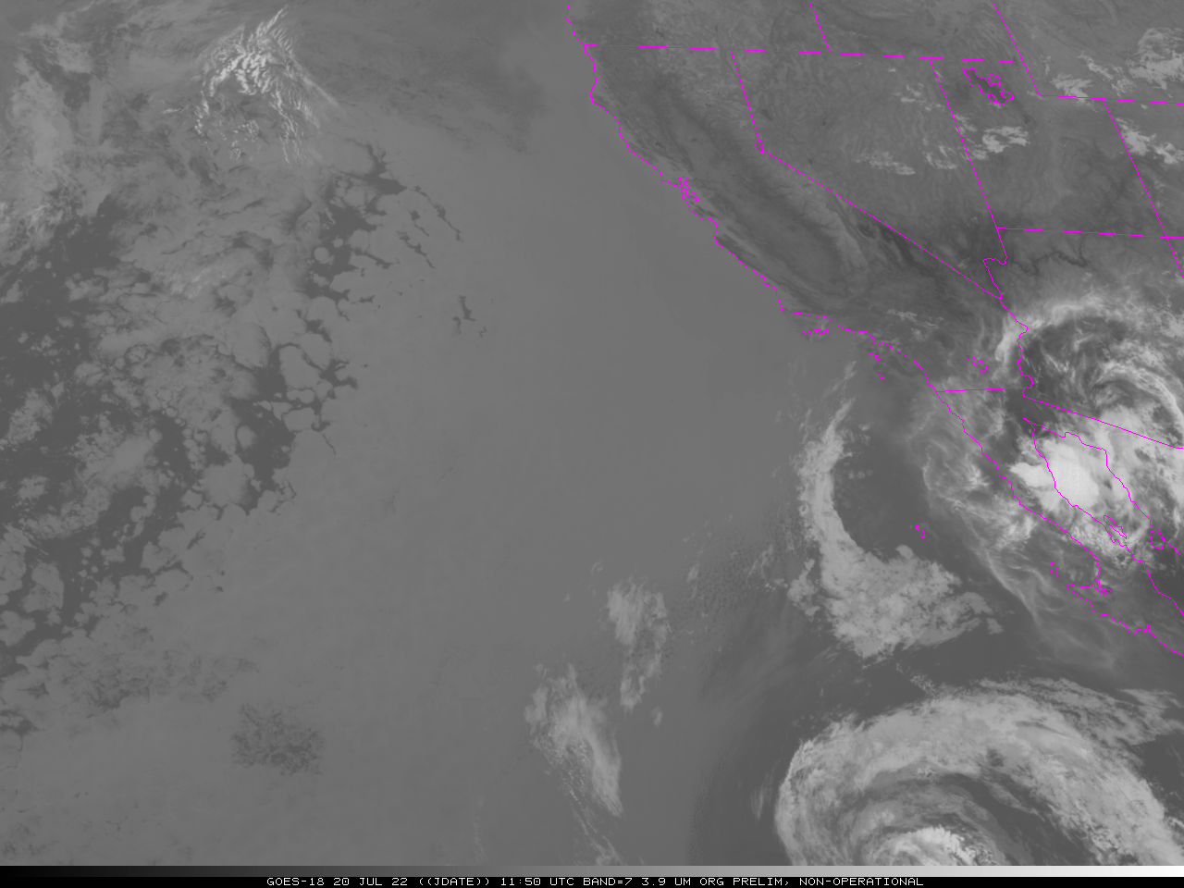
No Barcode Artifact Example, 2022/07/20
GOES-17
Band 07
2022/07/20 1150 UTC
GOES-18
Band 07
2022/07/20 1150 UTC

Slide 9
No Barcode Artifact Example, 2022/06/30
Fire temperature imagery with GeoColor overlay.
<click to animate>

Slide 10
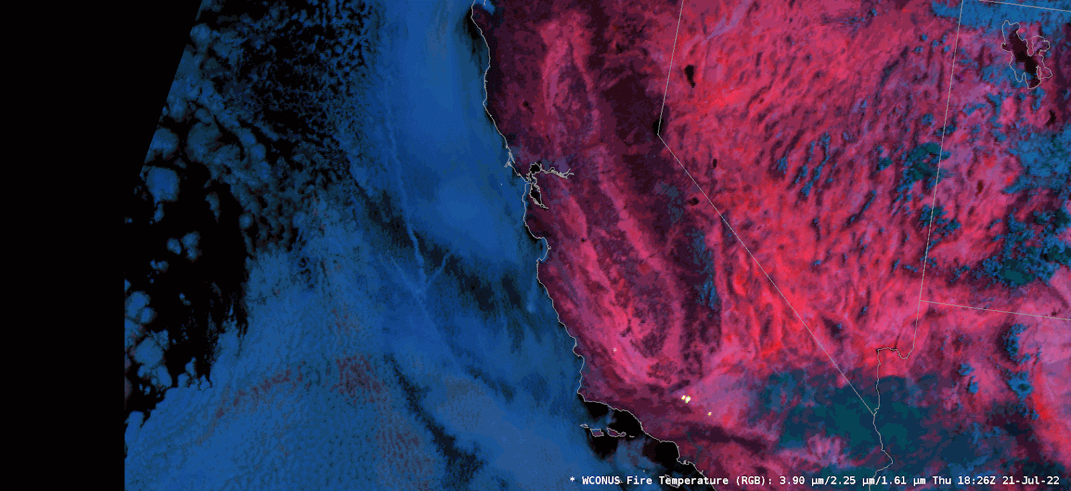
No Barcode Artifact Example, 2022/07/21
AWIPS Fire Temperature RGB
Reference: https://rammb.cira.colostate.edu/training/visit/quick_guides/Fire_Temperature_RGB.pdf

